Slide 1
Potential activity of methanogens
Karoline W. Noer
Master student
Supervisors:
Niels Peter Revsbech and Lars D.M. Ottosen

Slide 2
Goals
Estimate the potential activity of methanogens from anaerobic digesters
Methane production with and without hydrogen addition
Develop a method to compare the upgrading potential of different anaerobic digesters
Notes:
The goal of my studies is to develop an assay that will give a realistic and comparable estimate of the methanogenic activity in a anaerobic digester
I will evaluate the methane production rate with and without added hydrogen and compare it to the production in the reactor at the time of sampling.

Slide 3
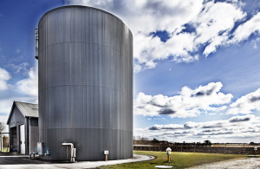
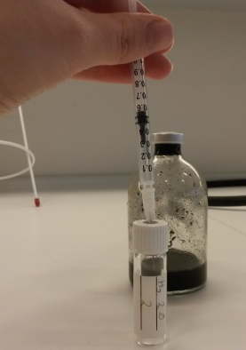
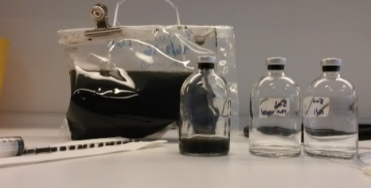
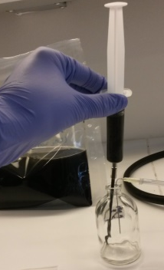
Potential activity assay
Collect material from anaerobic reactor
Gas fast bag with argon, directly from reactor
Material is transferred into serum bottles flushed with argon.
Headspace is flushed with the specific gas mixture
Flasks are incubated in rotor at temperature of the reactor
Gas samples from the headspace is collected every 30min for 2h
Methane measurements, GC-FID
Notes:
Basic procedure of potential activity assay
Evaluating and changing the assay continously
Dilution
Undiluted
Gas composition

Slide 4
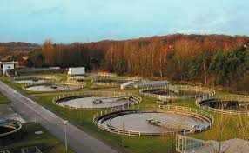
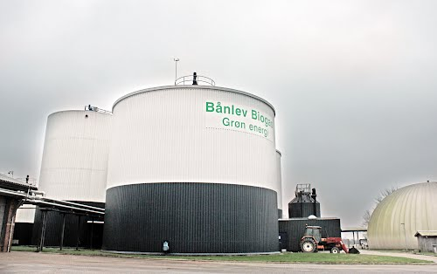
Anaerobic digesters
Anaerobic digester
Viby WWTP
Anaerobic digester
Åby WWTP
Anaerobic digester
Bånlev Biogas
Mesophilic 38°C
Primary and secondary sludge
(bioslam)
Thermophilic 49°C
Primary and secondary sludge (bioslam)
Mesophilic 39°C
Different waste and organic material from farms

Slide 5
Avoid mass transfer limitations - dilution of material
Dilution of the material from the digester with media (Pennings et al. 1998)
1:10 dilution
Headspace
H₂/CO₂ in 80:20 ratio
N₂ in control
Methane production over 2h
Methane production rate calculated from slope of linear regression
Measurements from Viby WWTP, Åby WWTP and Bånlev Biogas
Notes:
The first version of this experiment was where I diluted material from the reactor in a 1:10 ration with anaerobic media previously used for methanogens.
The serum bottle was flushed hydrogen/carbondioxide mixture 80% and 20%
The controle bottles was flushed with nitrogen. The trail with material from Viby to the right has 4 replica of the hydrogen/CO2 and controle.
As mentioned before the experiment is runned for 2h and gas samples from the headspace is taken every 30min.
From GC measurements the concentrations of methane in the headspace in the trail with viby material is seen in the graph.
Calculating the rate.
Done with material from anaerobic digesters at Viby WWTP, Åby WWTP and Bånlev biogas.

Slide 6
Rates of diluted material
Faster production with H₂/CO₂
Rates far lower than in the reactor
Chemical environment?
100%
Notes:
In the coloumn diagram to the right we see the methane production rates from trails with media diluted material from Viby, Åby and Bånlev.
In generel is the rate of the H2/CO2 samples higher than the controle samples (93%, 66%, 89%)
What is the reson for the low rates in the controles?
Chemical environment in the media? To big changes compared to in the reactor?
Try to dilute in saline water instead

Slide 7
Dilution in 0.5%saline water
Same procedure, 0.5% KCl water
Dilution series
Rates still does not match
10mL material with H₂/CO₂ headspace shows high rates
235%
100%
Notes:
Dilution in 0.5% kaliumchlorid dilution
Rates are still lower than in the reactor, and basicly the same rates as dilute in pennings, nothing really happens, very small amount of methane is produced test the volumen af material. As seen the larger amounts of material gives substantial higher rates, eventhough the controle is still lower than the reactor potential (but closer).
I tried to make a dilution series to

Slide 8
Test of dilution/undiluted
10mL pure material
1.5bar H₂/CO₂ or N₂/CO₂
Final pH*:
H₂/CO₂: ~9.50
N₂/CO₂: ~ 8.97
*after 3 days incubation
Methane production with different amount of material
10mL undiluted material with N₂/CO₂ closest to reactor levels
9% | 43% | 47% | 105% | 100% | 100%
Notes:
Tried with undiluted material, under pressure (1.5bar) → plenty of gas
Added CO2 to the controle to keep pH in material
High rates
Is it the added CO2?

Slide 9
CO₂ series
Buffer with phosphate buffer
Minimize the pH effect
Same procedure
N₂/CO₂ with different CO₂ concentrations
Not up to reactor rates
Same with 0.02M acetate
CO₂ do not seem to effect rate
11%
Notes:
Series with different CO2 concentrations
Add phosphate buffer to keep the pH from reaching inhibiting values
Acetate was also added to investigate if the low rates is due to low acetate concentration (as it is quickly depleeted when stopped feeding)
Lower rates than in the reactor. No clear patteren.

Slide 10
Next
Potential activity assay with 10mL pure material from different anaerobic digesters
Test the effect of VS concentration in reactor on the assay

