Slide 1
FOX / Partnership with a private sector
CORE Organic Pleaides Network meeting
18th October 2023 9:15 – 10:00
Peter Holl, DIL

Slide 2
FOX – Food processing in a Box
Aimes:
transforming large-scale technologies for the processing of fruits and vegetables, to small, flexible and mobile container units in your neighbourhood
FOX stimulates short food supply chains
transitioning from a more centralised industry, to local production hubs
4 food-circles are the 4 European regions in which the FOX technologies where demonstrated to be integrated into the entire food production chain
In these regions, which have significant fruit and vegetable productions (conventional and organic)
impact of the FOX approach on the environment, business, people and their health assessed
input from engaged consumers
further development and upscaling of FOX

Slide 3
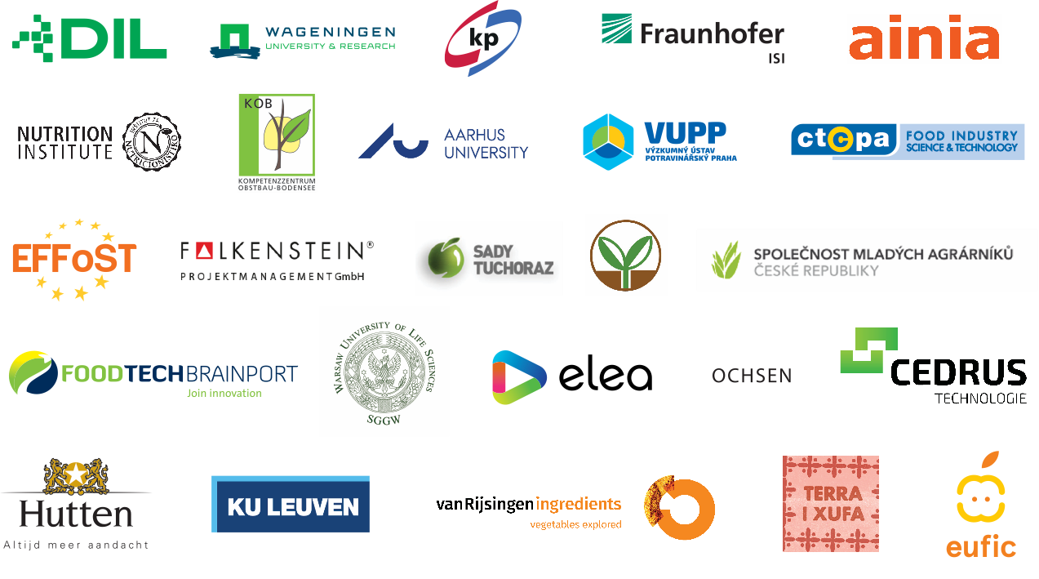
Our partners

Slide 4
4 FoodCirles – 4 Technologies
Food Circle 1 developed small-scale mobile processing unit for Low oxygen juice extraction and mild preservation
Low oxygen juice extraction and mild preservation
High-quality fruit juices and puree production
Flexible production for different types of fruits
Installation and operation on the farm(s)
High-quality fruit/puree production by downscaled, innovative technologies for low oxygen juice/puree extraction and low heat preservation

Slide 5
1 / Low oxygen juice extraction and mild preservation

Slide 6
1 / Low oxygen juice extraction and mild preservation

Slide 7
2 / Low temperature drying
Add value to fruit and vegetable products
Open new business opportunities for farmers
Manage the surplus of crops/produces

Slide 8
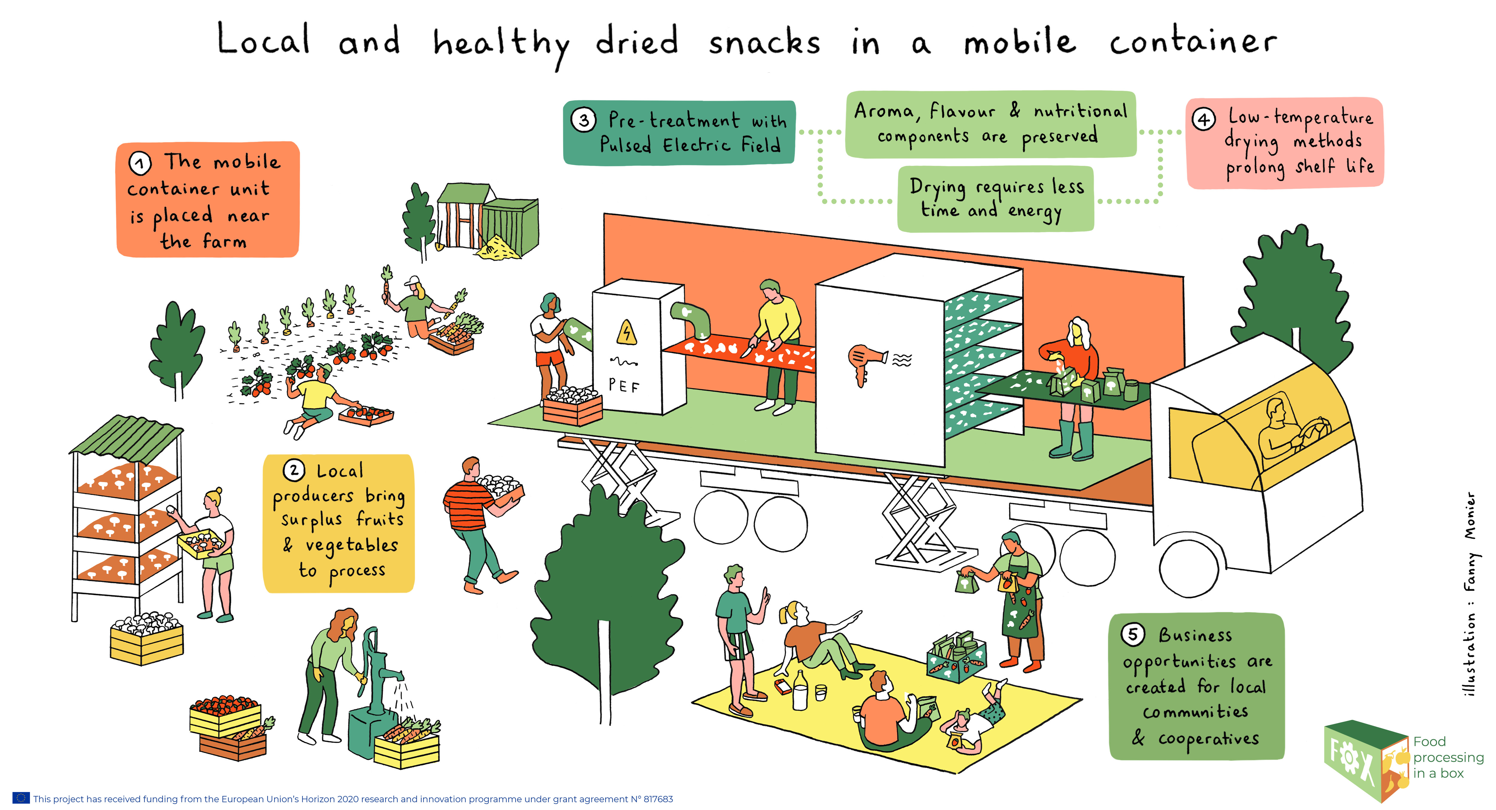
2 / Low temperature drying
Add value to fruit and vegetable products
Open new business opportunities for farmers
Manage the surplus of crops/produces

Slide 9
3 / Quality analyses and sustainable packaging
Mobile unit to select, process and package fresh-cut fruit and vegetable products
With sustainable packaging to enlarge the shelf life of fresh-cut fruit and vegetable products
For fresh-cut fruit and vegetable snacks produced by local producers
Encourage the consumption of fresh fruit and vegetables

Slide 10
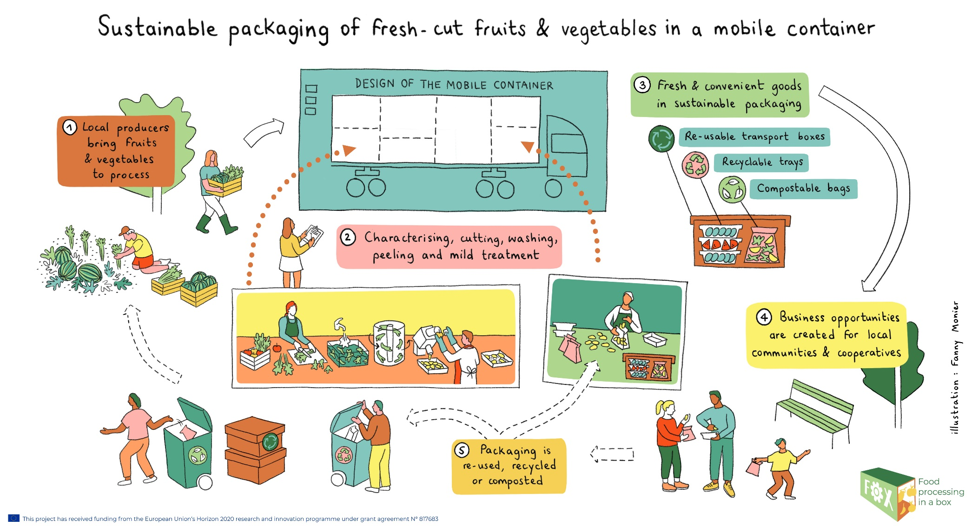
3 / Quality analyses and sustainable packaging
Mobile unit to select, process and package fresh-cut fruit and vegetable products
With sustainable packaging to enlarge the shelf life of fresh-cut fruit and vegetable products
For fresh-cut fruit and vegetable snacks produced by local producers
Encourage the consumption of fresh fruit and vegetables

Slide 11
4 / Upscaling plant side streams
Optimise vegetable-based food side streams
Create high-quality food products and ingredients via mild processing technologies
Develop pre-processing technologies for side streams
Processtimator tool
To explore different process routes for side stream fractionation and valorisation, while accounting for the impact on overall value, costs and greenhouse gas (GHG) emissions
side streams are characterized by daily availability and yearly volume, and on composition, both on major and valuable minor nutrients
After optimizing the operational window and equipment employment, the impact on mass balances and Opex/Capex is estimated.

Slide 12
4 FoodCircles

Slide 13
Foresight and Business models
Identifying and analysing trends influencing the food innovation system in the future
Developing scenarios for the framework conditions of the food innovation system
Drafting specific future scenarios for each food circle
Identifying business model elements for down-scaled food processing technologies, contextualized for different types of technology and socio-economic context
Validating the business models in the context of different future assumptions

Slide 14
Consumer Engagement
To engage the local consumers in the Food Circles two angles:
What are the current consumer values, attitudes and food purchasing behaviour?
What is the local consumers’ motivation and ability to engage in the development of a regional food circle?
The FOXLINK app
To serve as a communication platform between consumers and between consumers and suppliers.
with individualised profiles to give information on production technologies, impact on health, environment and rural life related to the Food Circle.

Slide 15
…. and now…..
please: ask me etherything ……
…… may I ask you someting

