Slide 1
Funding mechanism and organic research in „AGROECOLOGY“
Coordination: Nicolas Tinois, JÜLICH (DE)

Slide 2
In a nutshell
Large-scale European research and innovation endeavor
Support an agricultural sector to meet targets and challenges
Agroecology (AE) as a promising approach
Real-life testing and experimentation environments (Living Labs: LLs)
Research Infrastructures (RIs) making scientific knowledge available
Pool the resources of the EC and the states involved to fund high-level research: 150m€/150m€
70 partners from 26 countries
Basis: dossier and SRIA delivered by SCAR-AE

Slide 3
From the idea to the Partnership

Slide 4
It‘s a long way to go – The origins
6 Webinars 270+ participants
First exchanges on concepts, objectives and tasks
Kick-start dialogue
2020 |  | 2021 | 2022 | 2023
May-Oct
Notes:
Alternative to your slide „Origins"

Slide 5
It‘s a long way to go – The origins
New SCAR working group on agroecology (1 Jan 2021) => “drafters group”
28 countries (Member States and Associated Countries)
DE, DK, ES co-chairs
3 CSAs and FACCE-JPI special advisors
Agreeing on governance
6 Webinars 270+ participants
First exchanges on concepts, objectives and tasks
Kick-start dialogue
2020 |  | 2021 | 2022 | 2023
 | Jun-Dec

Slide 6
It‘s a long way to go – The origins
Barriers and opportunities
Vision and ambition
R&I needs
Intervention logic (objectives, activities, KPIs)
Funding scheme
Governance
Monitoring
New SCAR working group on agroecology (1 Jan 2021) => “drafters group”
27 countries (Member States and Associated Countries)
DE, DK, ES co-chairs
3 CSAs and FACCE-JPI special advisors
Co-creating the partnership’s dossier
Agreeing on governance
6 Webinars 270+ participants
First exchanges on concepts, objectives and tasks
Kick-start dialogue
2020 | 2021 |  | 2022 |  | 2023
 |  | Feb 2021 – Mar 2022

Slide 7
It‘s a long way to go – The origins
Barriers and opportunities
Vision and ambition
R&I needs
Intervention logic (objectives, activities, KPIs)
Funding scheme
Governance
Monitoring
Building on partnership’s dossier and past/ongoing research findings
Synergies with other partnerships and missions
New SCAR working group on agroecology (1 Jan 2021) => “drafters group”
27 countries (Member States and Associated Countries)
DE, DK, ES co-chairs
3 CSAs and FACCE-JPI special advisors
Co-creating the SRIA
Co-creating the partnership’s proposal
Agreeing on governance
6 Webinars 270+ participants
First exchanges on concepts, objectives and tasks
Kick-start dialogue
2020 | 2021 | 2022 | 2023
 |  | Jan 2022 – Feb 2023

Slide 8
The HEART of AGROECOLOGY: SRIA

Slide 9
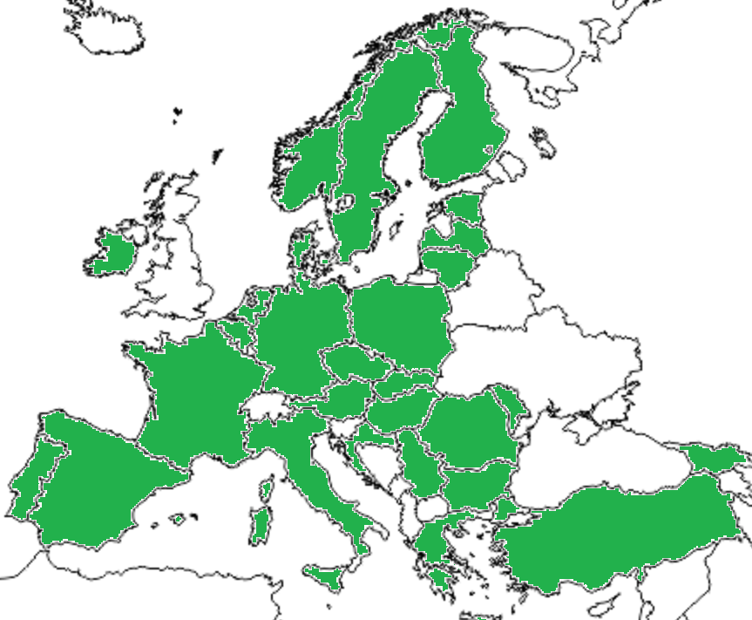
SCAR Agroecology SWG | SCAR-AE
+ Observers:
SCAR WGs
ETPs
ERIAFF
ERA-NETs
COPA-COGECA
Other Partnerships
La Via Campesina
EEB
Animal Task Force
IBMA
EuroCoop
EnoLL
IFOAM
BIOEAST
Birdlife
Agroecology Europe
in progress…
Co-chairs
Nicolas Tinois (DE), Torsten Rødel Berg (DK) Benjamin Sanchez (ES)
Mandate period
1/1/2020 - 31/12/2023
Members
28 countries + EC and key advisors
Overview members SCAR AE – update July 2022

Slide 10
Process of co-creating sria & agroecology
2021
2022
2023
2021 SCAR-AE TFs
Concepts
Barriers
Research needs
LLs and RIs
Governance
Funding
Inst. relations

Slide 11
Process of co-creating sria & agroecology
Dossier
2021
2022
2023
2021 SCAR AE TFs
Concepts
Barriers
Research needs
LLs and RIs
Governance
Funding
Inst. relations
sent to EC in Dec
Conceptual framework CTs:
Feedback in Mar
1st SRIA Event (Rev. CTs) Apr
external reviews

Slide 12
Process of co-creating sria & agroecology
Concept Paper
Involved groups:
SCAR AE drafting group & Intervention logic group
Involved groups:
SCAR AE DG & Plen. & SCAR AE SRIA Core team
2021
2022
2023
2021 SCAR AE TFs
Concepts
Barriers
Research needs
LLs and RIs
Governance
Funding
Inst. relations
sent to EC in Dec
Conceptual framework CTs:
Feedback in Mar
1st SRIA Event (Rev. CTs) Apr
external reviews

Slide 13
Process of co-creating sria & agroecology
Concept Paper
Involved groups:
SCAR AE drafting group & Intervention logic group
Involved groups:
SCAR AE DG & Plen. & SCAR AE SRIA Core team
2021 | Development Concept paper & conceptual framework
2022
2023
2021 SCAR AE TFs
Concepts
Barriers
Research needs
LLs and RIs
Governance
Funding
Inst. relations
sent to EC in Dec
Conceptual framework CTs:
Feedback in Mar
1st SRIA Event (Rev. CTs) Apr
1st consolidated draft SRIA
external reviews
1st consolidated draft SRIA
July

Slide 14
Process of co-creating sria & agroecology
Concept Paper
Involved groups:
SCEAR AE drafting group & Intervention logic group
Involved groups:
SCAR AE DG & Plen. & SCAR AE SRIA Core team
2021 | Development Concept paper & conceptual framework
2022
 | Consultations and reviews
2023
2021 SCAR AE TFs
Concepts
Barriers
Research needs
LLs and RIs
Governance
Funding
Inst. relations
sent to EC in Dec
Conceptual framework CTs:
Feedback in Mar
1st SRIA Event (Rev. CTs) Apr
1st consolidated draft SRIA
July
external reviews

Slide 15
Process of co-creating sria & agroecology
Concept Paper
Involved groups:
SCEAR AE drafting group & Intervention logic group
Involved groups:
SCAR AE DG & Plen. & SCAR AE SRIA Core team
2021 | Development Concept paper & conceptual framework
2022
 | Consultations and reviews
2023
2021 SCAR AE TFs
Concepts
Barriers
Research needs
LLs and RIs
Governance
Funding
Inst. relations
sent to EC in Dec
Conceptual framework CTs:
Feedback in Mar
1st SRIA Event (Rev. CTs) Apr
Public consultation
(Jul-Oct)
external reviews
1st consolidated draft SRIA
July
Input relevant EC services

Slide 16
Process of co-creating sria & agroecology
Concept Paper
Involved groups:
SCEAR AE drafting group & Intervention logic group
Involved groups:
SCAR AE DG & Plen. & SCAR AE SRIA Core team
2021 | Development Concept paper & conceptual framework
2022
 | Consultations and reviews
2023
2021 SCAR AE TFs
Concepts
Barriers
Research needs
LLs and RIs
Governance
Funding
Inst. relations
sent to EC in Dec
Conceptual framework CTs:
Feedback in Mar
1st SRIA Event (Rev. CTs) Apr
Public consultation
(Jul-Oct)
external reviews
1st consolidated draft SRIA
July
Input relevant EC services
SRIA SCAR-AE workshop & SCAR-AE Drafting group meeting in Nov

Slide 17
Process of co-creating sria & agroecology
Concept Paper
Involved groups:
SCEAR AE drafting group & Intervention logic group
Involved groups:
SCAR AE DG & Plen. & SCAR AE SRIA Core team
2021 | Development Concept paper & conceptual framework
2022
 | Consultations and reviews
2023
2021 SCAR AE TFs
Concepts
Barriers
Research needs
LLs and RIs
Governance
Funding
Inst. relations
sent to EC in Dec
Conceptual framework CTs:
Feedback in Mar
1st SRIA Event (Rev. CTs) Apr
Public consultation
(Jul-Oct)
external reviews
1st consolidated draft SRIA
July
Input relevant EC services
SRIA SCAR AE workshop & SCAR AE Drafting group meeting in Nov
2nd consolidated draft SRIA
Dec-Feb 2023

Slide 18
Common aims for AE
Reduction of GHG
Conserving resources (water, nutrients…)
Water retention
Resilience of agricultural systems to adapt to climate change
Adapt cropping patterns and field structures to landscape
Ecosystem services, biodiversity and beneficial biological interactions
Soil health and quality
Food competition between humans and livestock
Animal welfare and dual-purpose livestock
Social standards and sustainable value chains
Communication between producers and consumers

Slide 19
Intervention Logic
OO1. Support transnational research and innovation activities
OO2. Support research in and on LLs
GO1. Mainstream the principles of AE
OO3. Build and organise a European network of new and existing LLs
SO1. Increase research-based knowledge
SO2. Develop and co-create innovations
SO3. Improve the sharing and access to knowledge on AE
SO4. Build a monitoring and data framework
SO5. Exchange with policy makers and stakeholders
OO4. Build capacities of various actors
GO2. Build-up and expand collaborations to co-create and share knowledge and solutions
Common vision to “Team-up and unlock the transition to agroecology”
OO5. Improve access to and use of services provided by RIs
OO6. Set up a framework, data management, indicators, and tools to monitor AE transition
GO3. Contribute to fulfilling the SDGs and the Green Deal targets
OO7. Design and implement communication and dissemination activities
OO8. Put in place mechanisms for science-policy dialogue

Slide 20
key expected impacts to be achieved
A. Scientific (by 2030-2035)
Expected Impact 1: State-of-the-art science, research and innovation unlock the transition to agroecology.
Expected Impact 2: More evidence-based, open, flexible, participatory and risk sharing policies enable transformative changes in farming systems.
B. Societal including environmental (by 2040)
Expected Impact 3: Agricultural sector and rural areas are prosperous, attractive to young generations and connected to the rest of society.
Expected Impact 4: Stronger social capital, values, networks, skills and awareness of agroecology.
Expected Impact 5: Agroecological farming practices provide maximum positive contribution to biodiversity, climate and the environment, creating circular and sustainable farming systems.
C. Economic & technological (by 2040)
Expected Impact 6: Agroecology-based farming is economically viable.
Expected Impact 7: Agroecological farming systems and related value chains are resilient, productive, place-sensitive, widespread, and contribute to ensuring European food security, without compromising global food security, livelihoods and environment.
Expected Impact 8: Through Living Labs and networking of Living Labs, farmers are empowered and equipped with relevant knowledge and social, organisational and technological tools while supported by competent and independent advisory services to drive and scale up the transition towards agroecology.

Slide 21
Instruments | Living Labs (LLs)
ENoLL‘s five key elements of LLs:
Active user involvement,
Real-life setting,
Multi-stakeholder,
Multi-method approach,
Co-Creation (i.e. iterations of design cycles with different sets of stakeholders
AE LLs features:
Very strong local embeddedness,
Large diversity of their origins, from farm to networks or communities,
Heterogeneity and intensity of knowledge and innovations needed and produced (from practice to policies).
Different scales: farm and its immediate surroundings (network of farms), at the landscape or at the regional level.

Slide 22
Intruments | Research infrastructure (RI)
Allows scientists to observe, experiment and/or predict agroecosytsem and agri-food redesign
Contribute to build scientific knowledge on agroecology transition
Contributes to agroecology transition in terms of
Assessing environmental, social, economic impacts
Assessing vulnerability – adaptability – resilience
Forecasting dynamics
Some pan-European RIs of interest
ANAEE: soil-plant-atmosphere functioning (https://www.anaee.eu/)
EMPHASIS: plant phenotyping (https://emphasis.plant-phenotyping.eu/)
eLTER: socio-ecosystem concept, landscape scale – real life observations and modelling approaches (https://elter-ri.eu/)
LifeWatch: creates a virtual environment to store and explore data on agroecosystems (https://www.lifewatch.eu/)

Slide 23
SRIA : Core themes (ct)

Slide 24
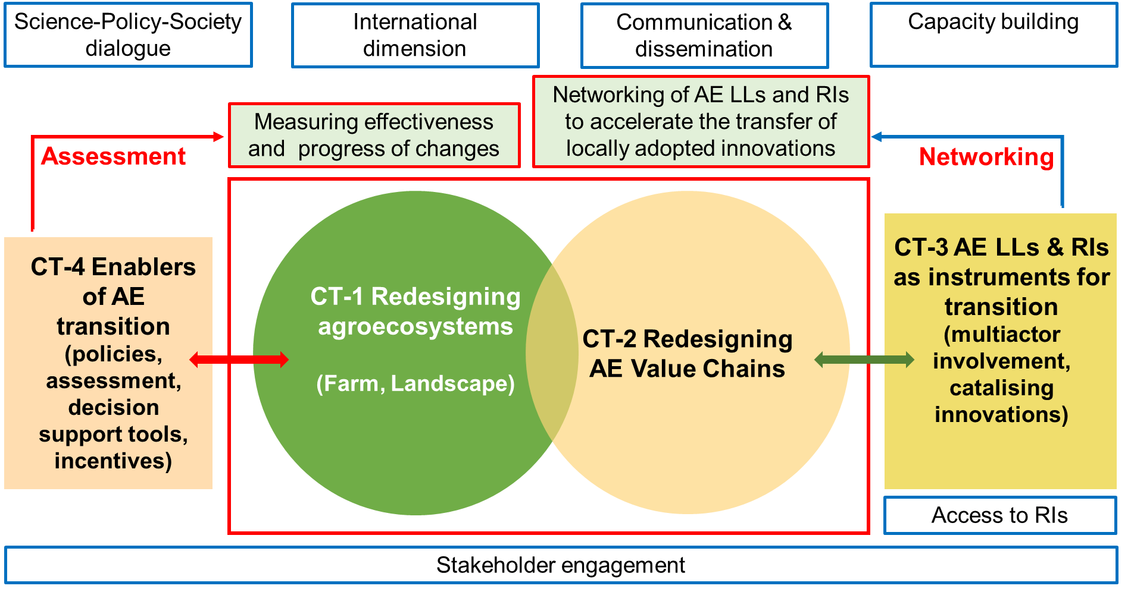
ct1 – redesigning agroecosystems
Supporting change of practice
Genetics and breeding for Agroecology
Managing pests and disease through innovative agronomic practices
Reducing fossil fuel inputs
Provision of ecosystem services
Restoration of biodiversity and nature
Landscape agroecology & territorial planning
Participatory landscape planning
Closing of nutrients and energy flows
Functional integration of different land and livestock uses
Decision support tools for agroecology farmers
Analysing social aspects related to agroecology transition
Farmer‘s motivations and obstacles
Inclusion dimensions (age, gender)
Role of common goods and engagement in AE transition
CT 1 – Redesigning
agrecosystems
(Farm, landscape)

Slide 25
ct2 – redesigning AE value chains
Coupling agricultural practices and value chain perspectives
Quality of AE products across the AE value chain
Adaptation of farming practices
Provision of technological innovations to cope with the heterogenetity of AE products and co-products
Traceability of products
Technologies and labelling
Developing and adapting business models
New circular, sustainable and resilient business models associated to shorter and fairer value chains
Adapted and alternative logistics and infrastructures
New or adapted machinery to reduce labour-intensive activities
Synergies of AE-based value chain with other co-existing in the same territory
CT 2 – Redesigning
AE value chains

Slide 26
ct3 – AE LLS & RIs as instruments for transition
Involvement of AE LLs and RIs in accelerating AE transition
Organisational models, methodologies and tools ensuring multistakeholder trust and involvement
Governance and coherent planning
Linkages of LLs with RIs accelerating transition
RIs role in supporting innovations and testing multidimensional scenarios related to AE transition
Assessing the impact of AE LLs and RIs (indicators & monitoring)
Identify indicators for technological innovations enhancement and implementation
Evaluation instruments adapted to spatial variations, level of maturity of LLs and RIs, and time span under evaluation
Assessing the individual performance of AE LLs & RIs
Finding incentives to engage all actors in AE transition
CT 3 – AE LLs & RIs
as instruments
for transition
(multiactor involvement,
catalising innovations)

Slide 27
ct4 – Enablers of Agroecology transition
Enhancing coherence between agricultural, environmental and other sectoral policies
Identify factors helping to improve coherence
Explore new institutional designs
Overarching evaluation of policies and research needs
Common Agricultural Policy related research needs
Developing decision-support tools for risk assessment, policy making and landscape planning
Building and testing scenarios
Building, adaption and combination of validated models to asess the three-dimensional sustainability of different options
Identification and testing of appropiate incentives
CT 4 – Enablers of AE
transition
(policies, assessment,
decision support tools,
incentives)

Slide 28
cross-cutting issues to scale-up transition
Networking of AE LLs & RIs to accelerate the transfer to locally adopted AE innovations
Validate criteria to set a EU network of LLs and RIs with wide coverage of local conditions and diversity of territories
Methodologies to enhance the uptake of innovations and their integration of value chains at larger geographical scales
Monitoring effectiveness and progress of changes at the EU level
Indicators related to economic, social and environmental dimensions
Monitoring and evaluation framework and tools

Slide 29
A few additional remarks…
Organic is a key practice to accelerate AE transition (+F2F target of 25%)
AE transition can learn from the advances of organic farming AND organic farming can benefit from AE research to go a step beyond in sustainability
Agroecology is “umbrella” / principles both for organic and other farmers
Cross-fertilisation between farming practices should be encouraged (AE…)
Though organic has particular challenges & specific needs

Slide 30
Preparing AGROECOLOGY

Slide 31
Partnership Preparation
April 2022: Commitments from MS/AC
Concept / WPs
Summer 2022: Interested partners from MS/AC joining
Initialising consortium
2022 |  | 2023 |  |  | 2024
Apr - Aug

Slide 32
Partnership Preparation
Meetings of MS/AC
WP-leads
Building WP-teams
Call opening Dec. 2022
Preparing for the call
April 2022: Commitments from MS/AC
Concept / WPs
Summer 2022: Interested partners from MS/AC joining
Initialising consortium
2022 |  | 2023 |  |  | 2024
Apr - Aug | Sep-Dec

Slide 33
Partnership Preparation
10 meetings of ET
Numerous WP-meetings
Proposal submitted 06.04.2023
ESR July 2023: 12,5/15
Meetings of MS/AC
WP-leads
Building WP-teams
Call opening Dec. 2022
Proposal submission & evaluation
Preparing for the call
April 2022: Commitments from MS/AC
Concept / WPs
Summer 2022: Interested partners from MS/AC joining
Initialising consortium
2022 |  | 2023 |  |  | 2024
Apr - Aug | Sep-Dec | Jan-Apr | May-Jul

Slide 34
Partnership Preparation
10 meetings of ET
Numerous WP-meetings
Proposal submitted 06.04.2023
ESR July 2023: 12,5/15
Meetings of MS/AC
WP-leads
Building WP-teams
Call opening Dec. 2022
Proposal submission & evaluation
Preparing for the call
GA preparation
Probably start early 2024
April 2022: Commitments from MS/AC
Concept / WPs
Summer 2022: Interested partners from MS/AC joining
Now & Later
Initialising consortium
2022 |  | 2023 |  |  | 2024
Apr - Aug | Sep-Dec | Jan-Apr | May-Jul | Aug 2023 – early 2024

Slide 35
introducting AGROECOLOGY

Slide 36
Fact and figures
Team-up and unlock the transition to agroecology so that farming systems are resilient, productive and prosperous, place-sensitive, as well as climate, environment, ecosystem, biodiversity and people-friendly by 2050
Start in early 2024, duration up to 10 years
70/26 partner/countries
National/Regional Authorities, research performers, ministries, ....
300M€ (50% co-fund)
Implementation: 8 WPs
Coordination: Nicolas Tinois, JÜLICH (DE)
Co-Coord.: H. McKhann, ANR (FR)

Slide 37
Resources | in cash
Overview
7 Co-funded calls planned
Approx. 100M€ for 3 Co-funded Calls
Internal and external RFOs from Europe and international
1st Co-Funded Call
Launch planned early 2024 (start partnership)
Budget ~ 35M€
Participating countries, state 18 Aug 2023

Slide 38
Overview Resources
Distribution WPs → Implementation
~ 13 % Internal Research (WP 7 & 8)
~ 7 % administrative (WP 1 & 6)
~ 8.5 % DEC incl. Science-Policy- interface (WP 3 &2)
~10 % Impact and SRIA (WP 5 & 4)

Slide 39
WP1: Coordination, administration and management
Task 1.1 Administrative and operational management
Task 1.2 Financial management
Task 1.3 Internal communication
Task 1.4 Management of the consortium bodies
Task 1.5 Management of advisory bodies
Task 1.6 Monitoring and Exploitation of the Partnership
Task 1.7 Synergies with other initiatives

Slide 40
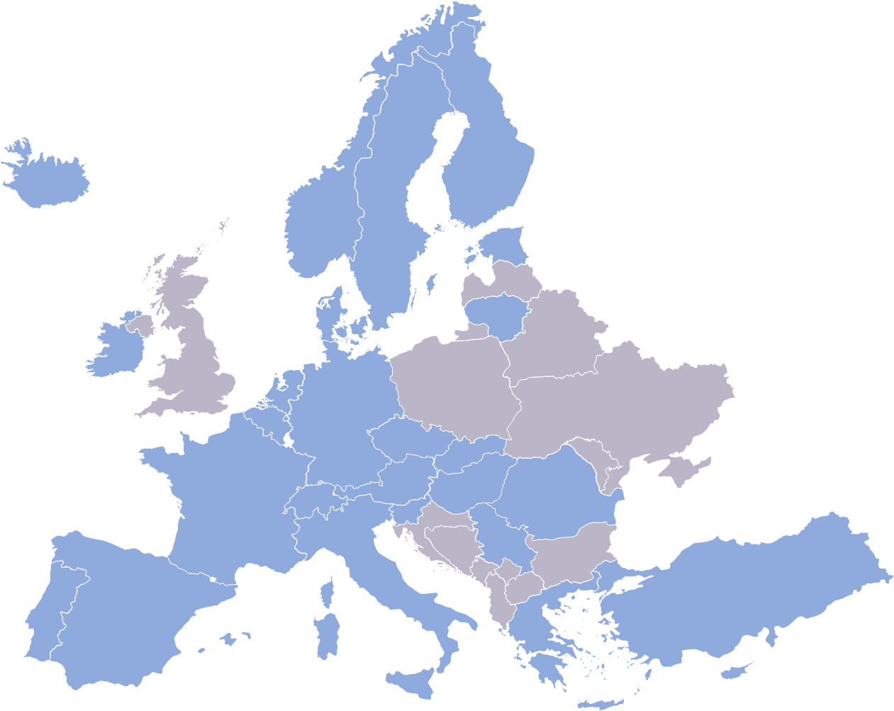
WP2: Science-Policy
Task 2.1 Benchmarking and assessing the implementation of current research and sectoral policies relevant for AE transition
Task 2.2 Improving capacity and governance of science-based policy advice at national and trans-European level
Task 2.3 Implementation of European Panel for Agroecology Transition
Task 2.4 Making evidence available for policymaking

Slide 41
WP3: Dissemination, Exploitation and Communication (DEC)
Task 3.1 Dissemination, exploitation and communication strategy/plan
Task 3.2 Online communication tools and channels
Task 3.3 Communication and promotional materials and supporting tools
Task 3.4 Dissemination and outreach
Task 3.5 Organisation of project meetings and knowledge exchange events
Task 3.6 Capacity building
picture: https://www.linkedin.com/pulse/social-media-marketing-future-brand-promotions-priyanshu-jha/

Slide 42
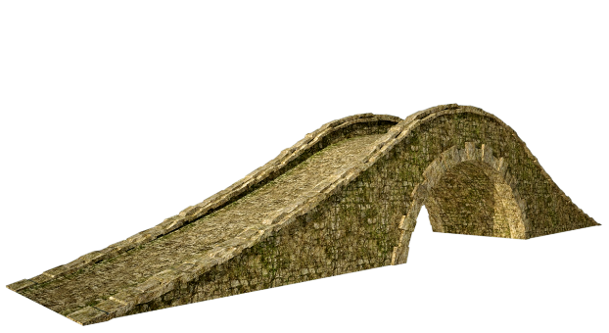
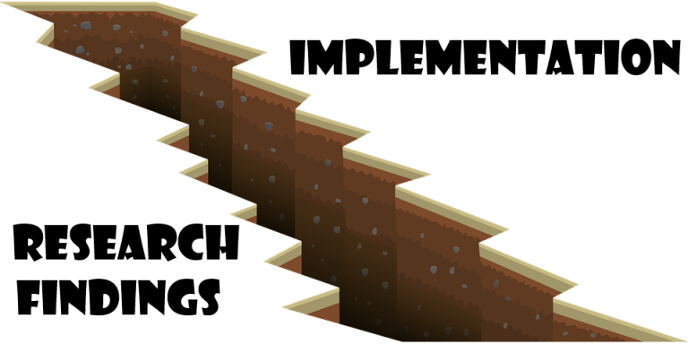
WP4: Updating the SRIA and defining the AWPs of AGROECOLOGY
Task 4.0 Elaboration and adoption of the first SRIA and AWP
Task 4.1 SRIA updates and shared R&I vision
Task 4.2 Preparation of subsequent AWPs
Task 4.3 Thematic coordination with other WPs and technical analyses of Partnership projects

Slide 43
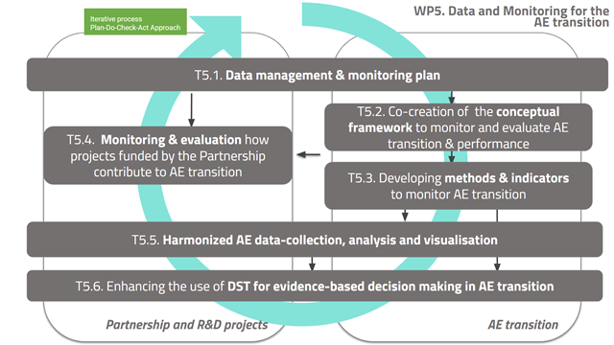
WP5: Data and Monitoring for AE transition

Slide 44
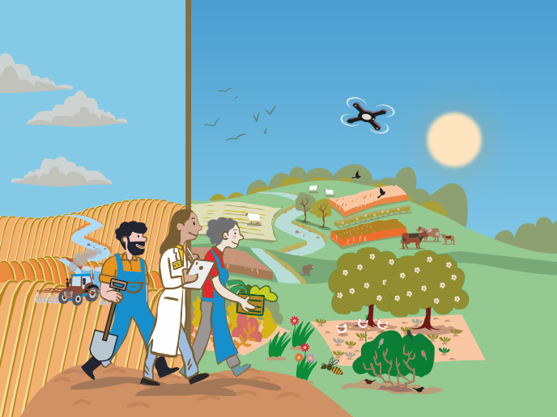
WP6: Managing transnational call activities
Task 6.1 Avoidance and Mitigation of CoI
Task 6.2 Call Office
Task 6.3 Proposal submission, eligibility check, evaluation and selection
Task 6.4 Project reporting
Task 6.5: New models of funding
picture: https://cordis.europa.eu/article/id/442635-agroecology-research-for-resilient-sustainable-climate-ecosystem-and-social-friendly-farming

Slide 45
Co-funded calls
Co-funded (EC+MS/AC) joint calls for transnational research projects
Aligned with HEUR rules & published in F&T Portal (+AGROECOLOGY website, ERA-LEARN, etc.)
Larger (budget) than in earlier ERA-NETs
Variable call geometry -> contractual link in the end between national/regional RFO and RPO (EC reimburses part of funding)

Slide 46
WP7: Expanding the capacities of LLs and RIs
Task 7.1 Coordinating the mobilisation of actors in AE LLs & RIs across Europe
Task 7.2 Synthesising and updating European inventories of AE LLs & RIs
Task 7.3 Identifying and engaging actors and stakeholders of the value chain promoting the development of new AE LLs
Task 7.4 Methodological guidance for developing and improving AE LLs
Task 7.5 Methodological guidance for developing and improving RIs
Task 7.6 Fostering synergies and capacity building of LLs & RIs

Slide 47
WP8: Coordination of the European Network of AE LLs & RIs
Task 8.1 Consolidation of the European Network of AE LLs & RIs and providing access to new members
Task 8.2 Management of the AE LLs & RIs Network
Task 8.3 Joint Network activities - empower actors in the production of new knowledge
Task 8.4 Collaborative Knowledge Platform of the Network
Task 8.5 Internal communication of the Network and cooperation with WPs of the Partnership
Task 8.6 Collaborating with other international networks and projects
Task 8.7 The added value and sustainability of the Network

Slide 48
A „partnership landscape“ (cluster 6)
E.g. Data-based tools to enable the AE practices; Monitoring progress, impact of AE transition; LL and infrastructure as source of data
E.g. Farming <> biodiversity; Ecosystem protection and restoration; Multi-functional landscapes; Functional biodiversity; AE practices for the preservation of biodiversity
E.g. Benefits of agroecological systems for animal health and welfare (guiding principle); AE as tool for reduced use of antimicrobials; Safety of animal effluents used as fertilisers
E.g. Consumer pull for ecological products; Value chain/Business Models, Food processing for AE products (lock-ins); Drivers & incentives; Ensure an integrated approach to food systems from production to diets

Slide 49
Thank you!
Picture credits front page: 3D Assembly: Project Management Jülich, Forschungszentrum Jülich GmbH; Pictures: IvanMikhaylov/iStock/Thinkstock, palau83/iStock/Thinkstock, PN_Photo/iStock/Thinkstock

