Slide 1
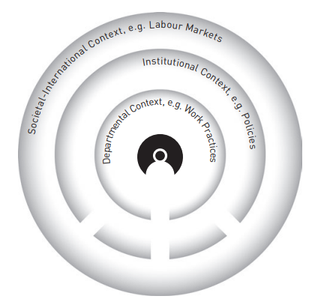
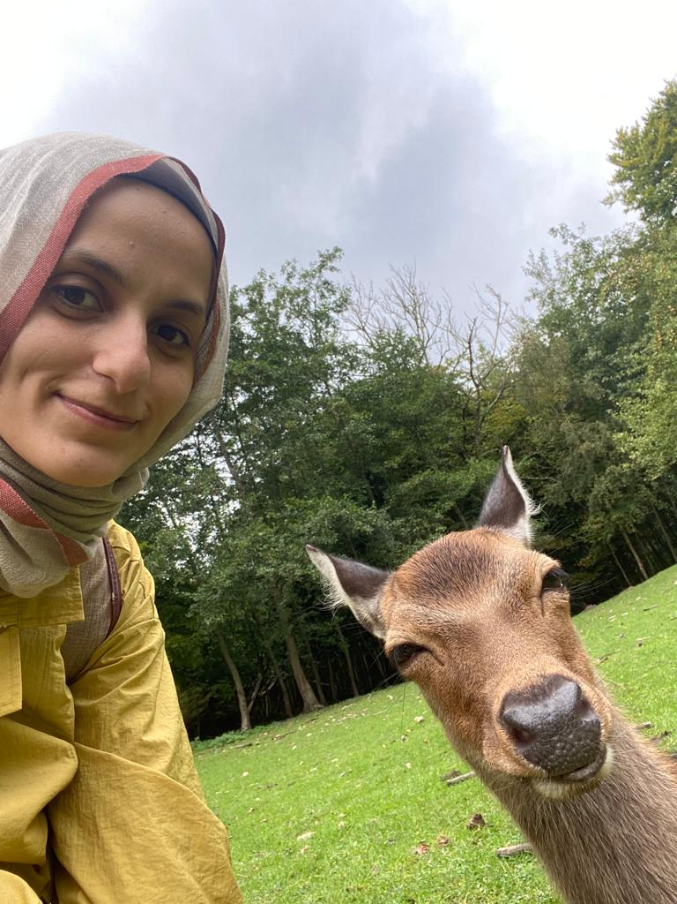
An ecological inquiry into societal significance of PhD research/ers in humanities DPU fall symposium 2021
[Poster NO]
The significance of the doctoral-level humanities research is overshadowed by the “permanent crisis” debates on the humanities (Reitter &Wellmon 2021). In a neoliberalised higher education context, getting a PhD degree means pursuing advanced research while striving to build a career with limited the employment prospects (Bengtsen 2019). This leaves PhD students orphaned by the very institution that is supposed to take care of them (Wisker & Robinson 2012). Against such an entangled background, this PhD project (WP-3) aims to reassert the great value and potential for impact advanced humanities research/ers bear for the society. It is an attempt to explore the matter through a student lens and understand the researcher views on their position and the significance of their research in the society. It is an arduous journey of hunting together with fellow PhD researchers, for better ways of asserting the value our research carries.
Central Concepts
Ecological approach centralizing the concept of responsibility of the university (Barnett, 2018);
“nested contexts” which showcases the multi-layered relationality students are positioned within and identity trajectories more than one role researchers bear (McAlpine & Amundsen 2018)
Design & Methods
Qualitative research involving in-depth interviews with PhD students & post-PhDs;
(Participant) observation in PhD collectivities;
Co-generating data with fellow researchers; longitudinal
Autoethnography?
Who am I
Hatice Nuriler- PhD fellow
Background in literature; cultural studies; sociology
from Turkey
References: Barnett, Ronald (2018) The Ecological University. Routledge; Bengtsen, Søren S.E. (2019) “Building Doctoral Ecologies and Ecological Curricula” in Barnett, Ronald, Jackson, Norman eds. Ecologies for Learning and Practice, Routledge; McAlpine Lynn
Amundsen, Cheryl (2018) Identity Trajectories: Unpacking the Post-PhD Experience, Palgrave Macmillan. Reitter, Paul, Wellmon, Chad (2021). Permanent Crisis: Humanities in a Disenchanted Age. The University of Chicago Press; Wisker, G., Robinson, G. (2012). Picking ip Pieces: Supervisors and doctoral ‘orphanes’. International Journal for Researcher Development, 3 (2), 139-153)-

