Slide 1
Japan and EU/Denmark at tema port, ghana

Slide 2
EU/Japan Coordinated responses
Common challenges, common responses
Markets, resources, access
SDGs
The African continent access
A case in point: Tema Port in Ghana
Access to markets in Ghana and LDCs: Burkina Faso, Mali, and Niger
UK, Japan, Denmark, France, EU?
Coordination, competition, and common interests

Slide 3
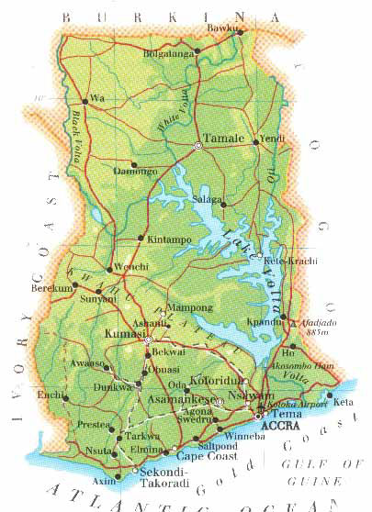
Tema port – access for all
Infrastructure connecting ports, roads, rail,
and waterways
Access to all of Ghana and LDCs
Burkina Faso, Mali, and Niger
Competing ideas
Roads, rail or waterway
Transport Ministry
Ministry of Roads and Highways

Slide 4
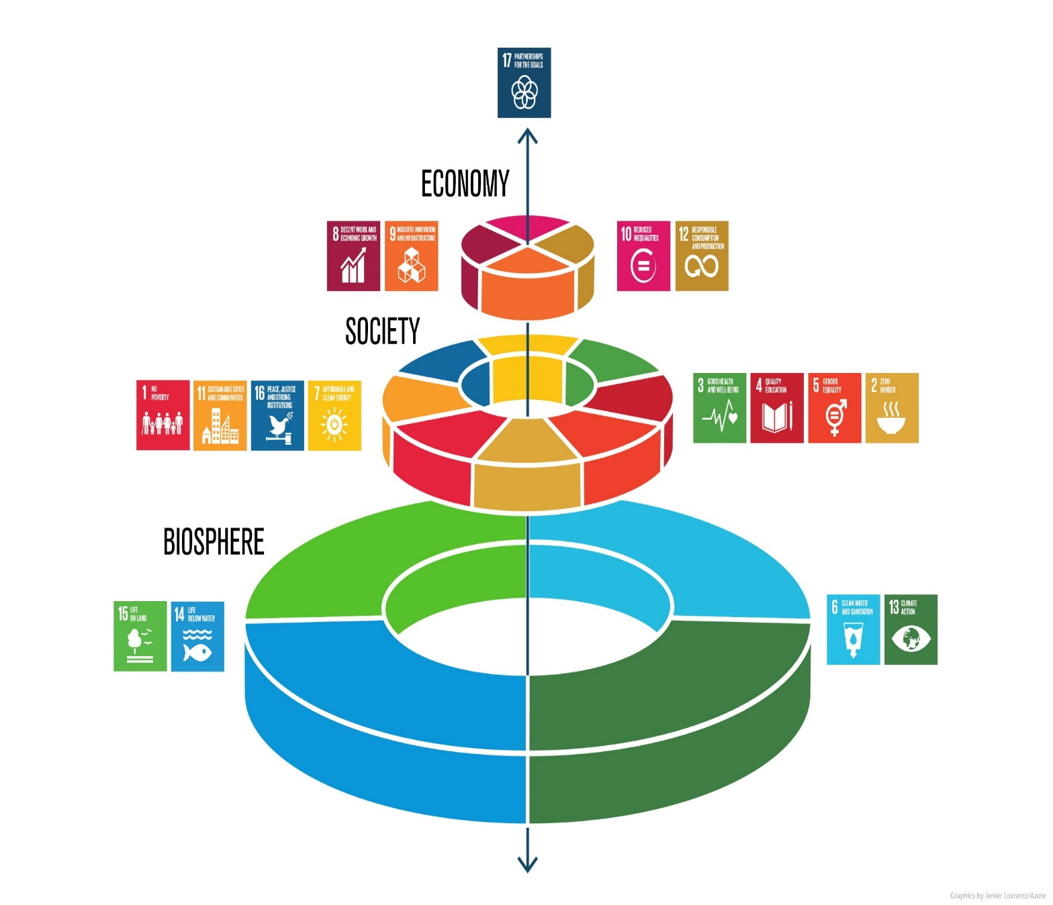
Common challenges
Coordination
Ghanaian ministries and private sector
European diplomacy and private sector – aid to trade
Distribution of wealth for a growing market in Ghana and LDCs
Geographical/social distribution
SDGs and climate change
Corruption

Slide 5
Common responses with variation
Different strengths –
Amount of money
Local historical networks
Aid experiences since 1960s
Contributions
Competing and overlapping
Complementary
Aid or trade, ODA or FDI, or ?

Slide 6
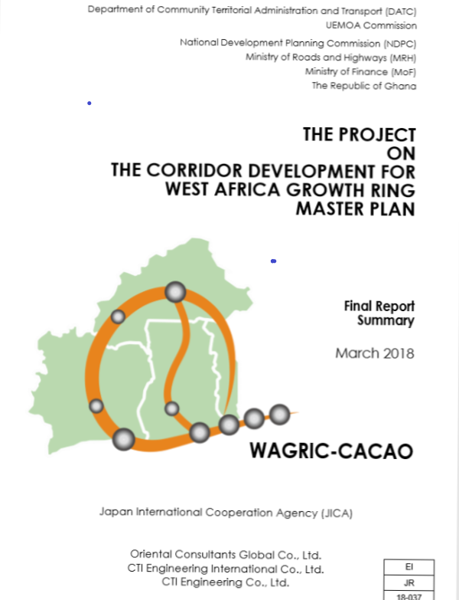
JAPAn’s responses in infrastructure
ODA financed projects to attract Japanese
FDI. JICA invited to quarterly transport sector
working group meetings
1985 – JICA Port Rehabilitation project
1993 – JICA Road Rehabilitation project
2001 – JICA designed master plan for expansion of Tema Port
2016 – JICA bridge on Eastern corridor
2017 – N8 Eastern corridor rehabilitation
2017 – Road rehabilitation by Ougadougou, Burkina Faso
2018 – Final report on West Africa Growth Ring (WAGRIC)
Master Plan by JICA
2018 – Grade separation intersection at crossroads for N8,
Tema Port expansion, and Abidjan-Lomé road.
Notes:
https://s3-us-west-2.amazonaws.com/new-ndpc-static1/CACHES/PUBLICATIONS/2018/07/05/1_WAGRIC-CACAO_Summary_Report+(Final).pdf
In the Transport sector, donor coordination is quite advanced with several Development Partners (DPs) supporting Ghana’s transport sector. These include the Bank, the World Bank, AFD, JICA, China, Brazil, KOICA, EU and SECO. There is an active DPs Transport Sector Group (TSG), which holds quarterly meetings to coordinate various DP interventions. The Bank currently co-chairs the Transport Sector Group. (https://www.afdb.org/fileadmin/uploads/afdb/Documents/Boards-Documents/GHANA_-_AR-_Accra_Urban_Transport_Project.pdf p.2)
Doing business in Ghana, infrastructure section
https://www.jica.go.jp/ghana/english/activities/c8h0vm00004bps0w-att/ghana_01.pdf
2012 workshop and survey
Infrastructure loan December 2016 announcement
https://www.jica.go.jp/english/news/press/2016/161209_2.html
https://www.jica.go.jp/ghana/english/office/topics/press_121122_01.html
Grant agreement Apr. 3, 2017
https://www.jica.go.jp/english/news/press/2017/170821_02.html
Burkina Faso
https://www.jica.go.jp/english/news/press/2017/170403_04.html

Slide 7
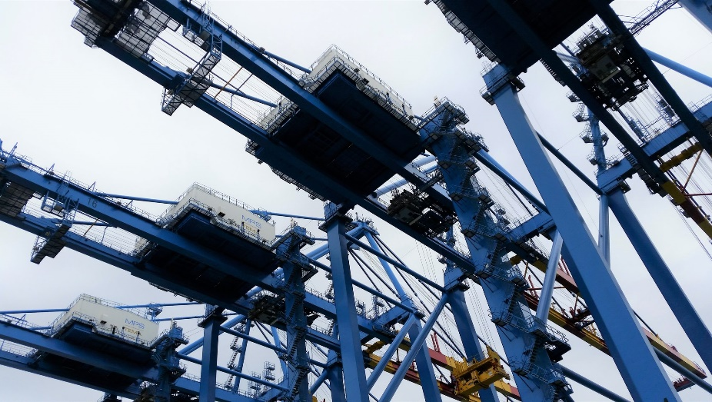
European responses in infrastructure
Predominantly private companies. However, EU AID is part of the Transport Working Group
1956-1962 UK – Sir W. Halcrow engineers
1988 DK - Maersk Line opens office in Tema and has almost 50 % of all shipping of both import and export goods between West Africa and Far East in 1988
2005 DK/French - APM Terminals and French Bolloré form Meridian Port Services (MPS) together with the Ghanaian government in 2005.
2010 USTAID adjusted Master plan
2018 EU Phase 2 project to facilitate transport
on the Abidjan-Lagos corridor of WAGRIS
2016-2019 MPS builds new MPS terminal

Slide 8
Entangled timeline
1962 (UK)
Tema port completed
1985 (JICA) Ports Rehabilitation Project
1988
Maersk Line office in Tema
2016 (JICA) New bridge construction across the Volta River on Eastern Corridor
2017 (JICA) Project for Rehabilitation of National Trunk Road N8
2017 (JICA) West Africa Growth Ring Master Plan, including improvement of bypass road in Ougadougou and Grade separation of Tema intersection
2019 (MPS) widen road by new terminal
2019 opening of new MPS terminal in Tema
2005 APM Terminals, Bolloré, and GPHA form MPS
1993 (JICA) Roads Rehabilitation Project
2001 (JICA) Master Plan Port

Slide 9
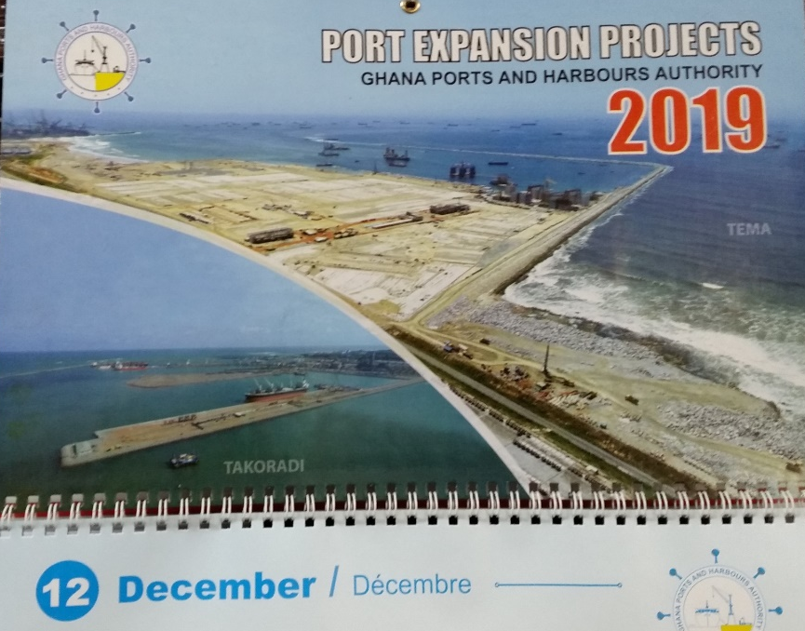
Competing and coordinated responses
Japan/EU
JICA and EU are working directly with the Ghanaian
Transport Ministry and Ministry of Roads and Highways to advice on and influence policy. JICA has prepared master plans for port expansion and for WAGRIS. Besides, JICA funds projects enabling succesful implementation of master plan – better roads to connect Tema Port expansion to LDCs.
Denmark/France/EU
European responses in Ghanaian infrastructure sector are primarily not EU, but private companies with roots in one European country or multinational initiatives that respond to policy and master plans influenced by JICA and only secondarily by EU.
Notes:
Photo on the wall in new MPS terminal meeting room.

Slide 10
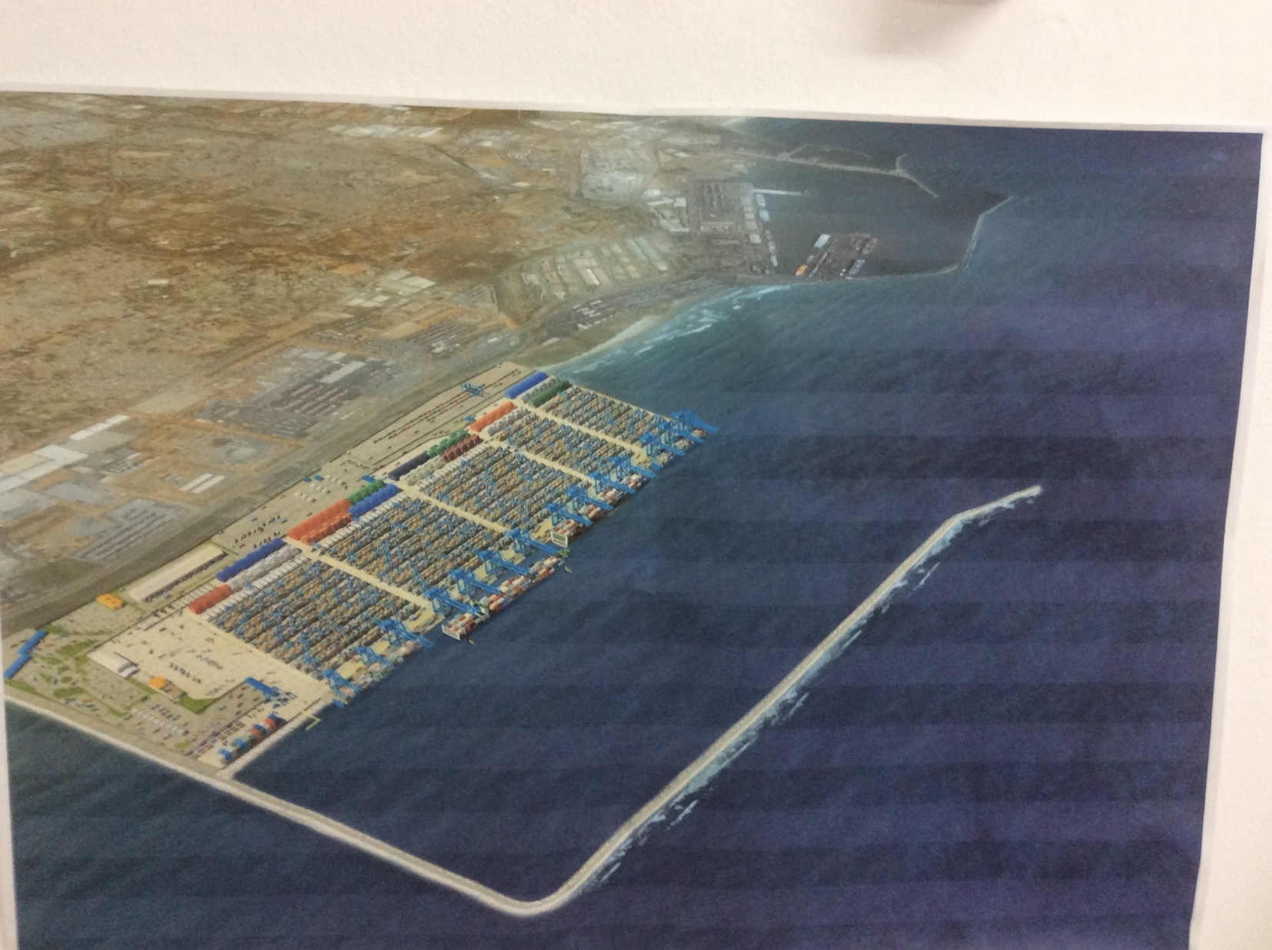
Future prospects drawing on past experiences
Accessing Africa as a common challenge – and how EU/Japan challenges or benefits Tema and Ghana responses to SDGs
EU coordinated response – port expansion, HR, Education, Health
Japan/EU coordinated response – port as integral part of WAGRIS
Private/public coordination – Maersk Line and MPS, Ghana Port and Harbour Authority (port as gateway between sea and land), Ministries of Transport and of Roads and
Highways (land), and
Maritime Authorities (at sea)
Notes:
Source: presentation J. Rockström and P. Sukhdev at EAT conference referenced at http://www.teebweb.org/sdgs/ Latest retrieval on June 3, 2019.

